Slide 1

Marathwada Mitra Mandal's
COLLEGE OF ENGINEERING, Karve Nagar, Pune - 52
An Autonomous Institute Affiliated to SPPU
Website: www.mmcoe.edu.in email id: mmcoe@mmcoe.edu.in
Department of Information Technology
Project Based Learning - Review 2 (AY 2025-26)
“Emergency Service Platform”
Presented By: SI145 Harshwardhan Khaire
SI138 Pranav Chavan
SI141 Sonal Karche
SI126 Sanika Potdar
Name of Guide: Dr. Prakash Gadekar
Name of Sponsor: (If applicable)
29/10/2025
Date:

Slide 2
CEP Project Title
Title 1
Context of the project : In emergencies, people struggle to find and contact the right service quickly. Delays in reaching fire, police, ambulance, or nearest help can cost lives and property. A single app integrating all emergency services can bridge this gap. It is often observed that during emergencies, more than one service (e.g., ambulance and police) is required simultaneously, making coordination difficult. Area/Community of focus : Urban communities, where response time is critical.

Slide 3
Proposed Solution
Description :
A unified digital platform connecting users to ambulance, police and fire station.
Allows users to request emergency help instantly via web or mobile app.
Uses real-time GPS tracking to locate users and route requests to the nearest service.
Provides live status updates — Accepted, On the Way, Resolved.
Ensures faster response, clear communication, and public transparency.

Slide 4
Proposed Solution
Technology Stack
Frontend
HTML, CSS, JavaScript
Leaflet.js (Maps)
OpenStreetMap API
Backend
Node.js + Express.js
APIs Used
Geolocation API (Live Location Tracking)
localStorage API (Data Storage)
OpenStreetMap Tile API (Map Data)
Tel Protocol (Emergency Calling)

Slide 5
Proposed Solution
UI/UX
Responsive Design
Progressive Web App (PWA)
Google Fonts (Inter)
Custom Animations & Gradients

Slide 6
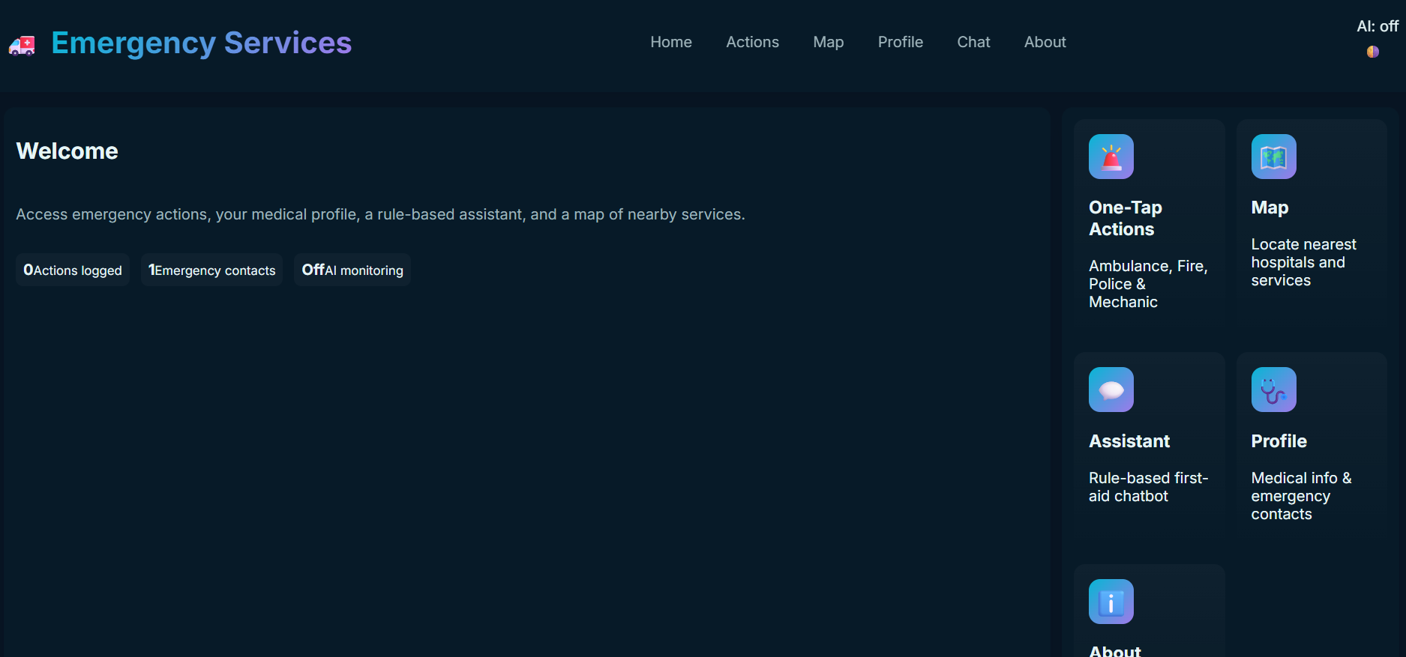
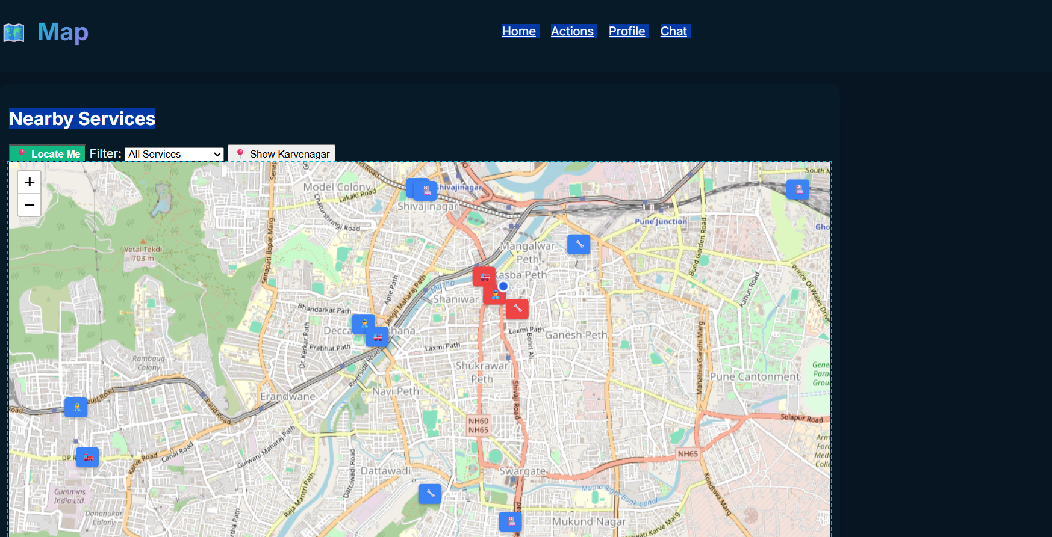
Prototype or Model
Photos/screenshots
How it works

Slide 7
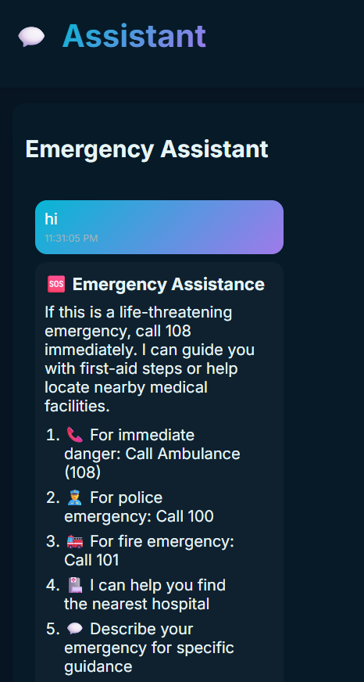
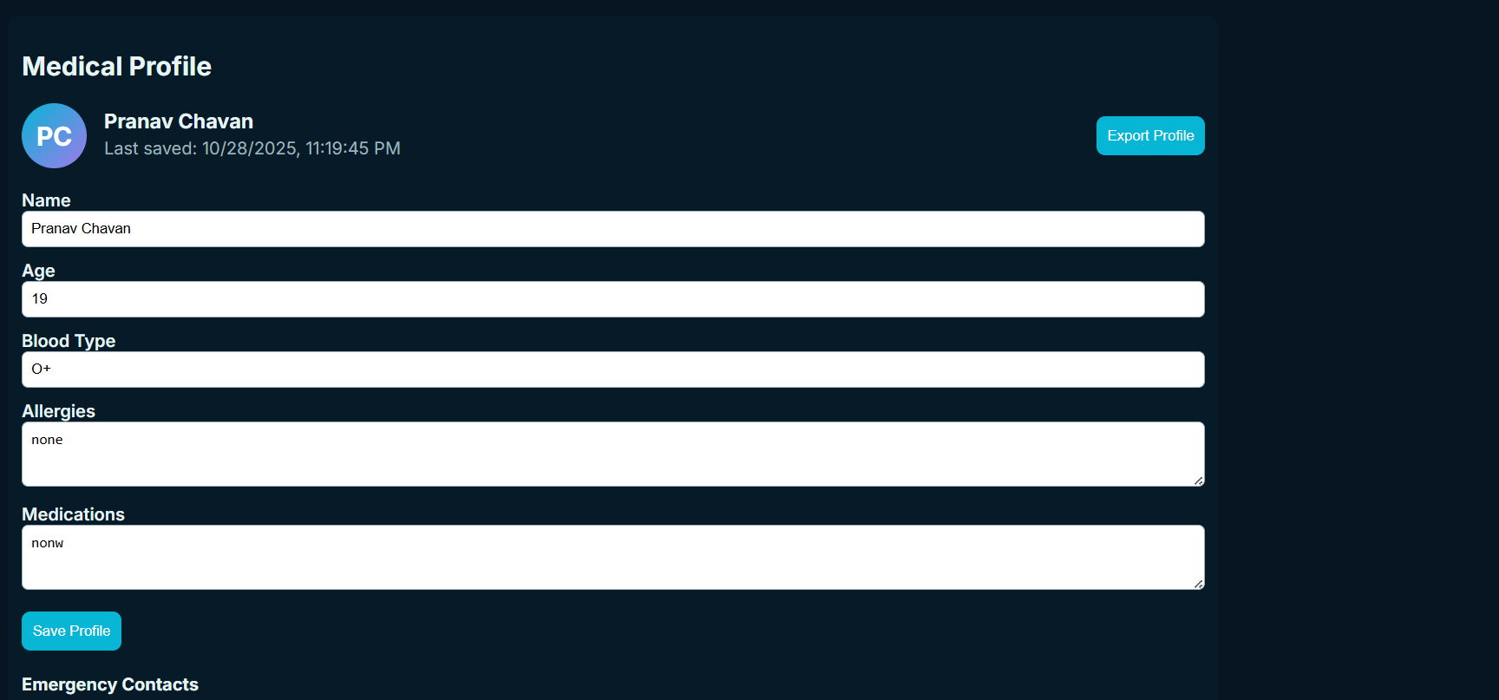
How it works

Slide 8
Testing and Feedback
Testing & Feedback
Testing
Conducted simulated emergency scenarios to test workflow efficiency.
Sample users entered emergency requests via mock interface (web/mobile).
Verified response flow between user, service provider, and volunteer dashboards.
GPS tracking and status update simulation tested for accuracy and timing.
System evaluated for usability, clarity, and notification reliability.
Feedback
Users: Found the interface intuitive and easy to use during simulated stress conditions.
Service Providers: Appreciated the centralized dashboard for managing multiple cases.
Overall: Positive response to concept; users valued real-time updates and transparency.
Recommendations included adding emergency contact auto-dial and offline support in low-network areas.

Slide 9
Feasibility and Sustainability
Can it be scaled or maintained?
Built using modular architecture, allowing easy addition of new features or services.
Regular maintenance and updates can be managed by a small technical team.
APIs and dashboards ensure smooth integration with new emergency agencies or partners.
Open for future expansion to rural areas or nationwide coverage.
Cost and complexity
Development Cost: Moderate — mainly for server setup, APIs, and app development (required in future development).
Maintenance Cost: Low to medium — depends on hosting and periodic updates.
Complexity Level: Medium — involves integration of multiple services and real-time GPS tracking.
Use of open-source tools and cloud services reduces overall expenses.
Long-term sustainability achievable through government or NGO partnerships and community adoption.

Slide 10
Final Outcome
Before vs. After comparison
Before:
Users had to call multiple numbers for different emergency services.
Response time was slow and coordination poor.
Limited tracking or transparency once help was requested.
After:
All emergency services accessible from one digital platform.
Faster response through automated routing and GPS tracking.
Live status updates ensure better transparency and user confidence.

Slide 11
Final Outcome
Impact Estimate
30–40% reduction in average emergency response time (estimated).
Improved coordination among police, fire, ambulance.
Increased public trust through transparent tracking and reporting.
Potential to save lives and property with timely intervention.
Promotes community involvement via volunteer participation.

Slide 12
Team Contributions and Learning
Role of each member :
  Pranav Chavan - Tech Stack and API
  Sonal Karche - Problem Statement and Frontend
  Sanika Potdar - Documentation
  Harshwardhan Khaire - Research and Design
Reflection / Learnings
Real-world problem analysis
Application of web/mobile integration
Basics of APIs, GPS, and cloud systems
Team coordination and technical documentation

Slide 13
Future Scope
Future Scope
Smart AI Chatbot & Voice Assistant
Live Video Consultations
Secure Database
Real-time Hospital Bed Availability
Multi-language Support
Blockchain for Medical Records
Community Volunteer Network
End to end encryption
Offline Map Downloads

Slide 14
Thank You

